Slide 1

Proposal for [CUSTOMER]
29 June 2022
[SALES REP]
Account Executive
[PHONE]
[EMAIL]
Book a call: [CALENDLY LINK]

Slide 2
Workyard: A powerful workforce management solution for [CUSTOMER]
It's 2022, but [solar companies] are still struggling to find the tools to help improve the productivity of their teams. We believe they deserve a better way.
‍
Workyard is a game-changing workforce management platform that helps [solar companies] improve profits by helping them better manage their work and track their costs in real time.
Thank you for this opportunity to submit a proposal to [CUSTOMER].

Slide 3
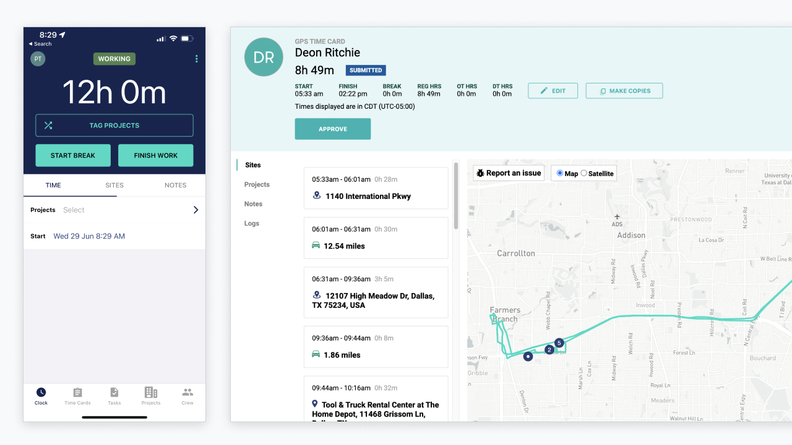
Key Issue #
Inaccurate time tracking of hourly workers is costing you money.
For a team of 340 workers earning an average of $25 p/h, if their timecards are off by an average of 10 minutes per day, that’s costing you $1417 per day!
Time Card View Detail View with GPS on the web app
Solution: Workyard’s GPS time clock ensures you have complete transparency across your whole team and your payroll is accurate, every time.

Slide 4
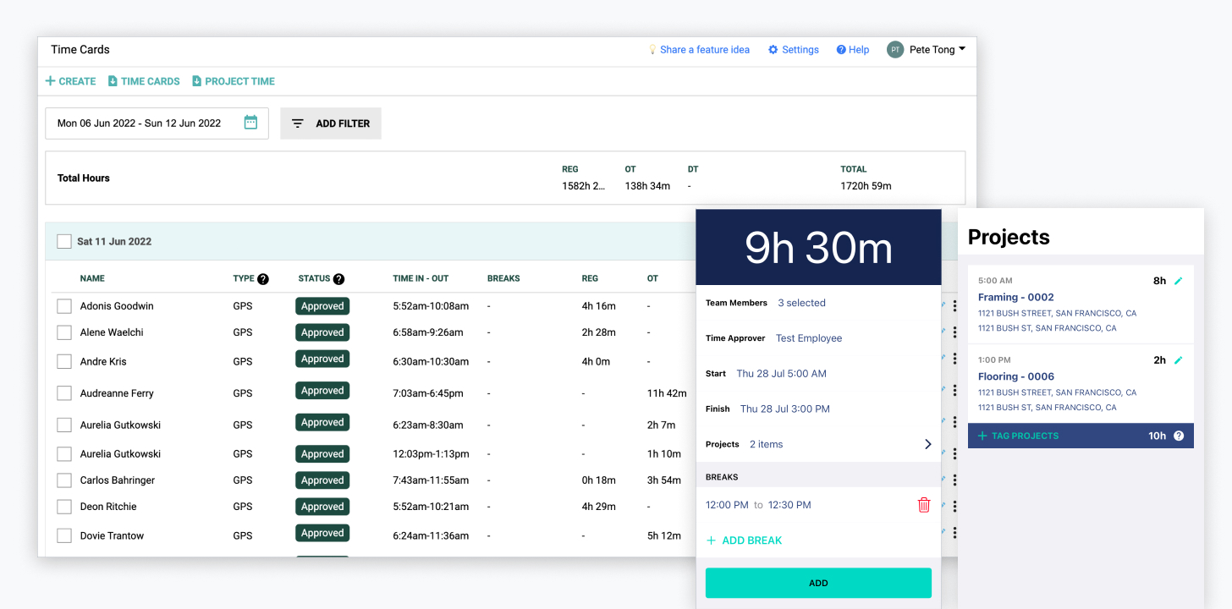
Key Issue #
Making it easy for your supers to accurately record time in the field.
Time Card View Detail View with GPS on the web app
Solution: Workyard’s mobile bulk time entry allows supers to enter time for their whole team including jobs and cost codes with a couple of taps.

Slide 5
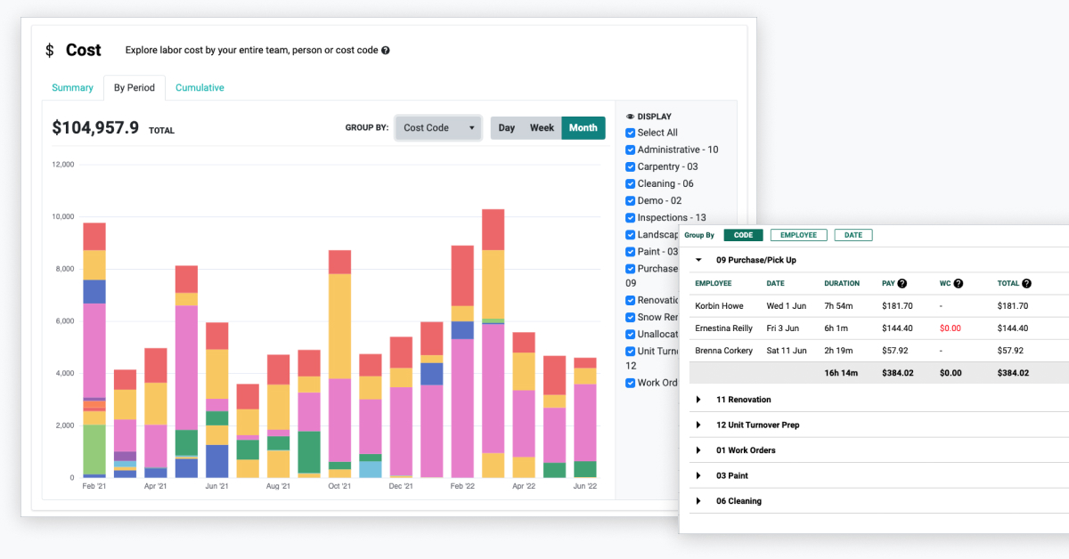
Key Issue #
Tracking exactly how many labor hours and dollars you are spending on each job
You want this information always up-to-date and accurate, not when it’s too late and the project is over.
Time Card View Detail View with GPS on the web app
Solution: Labor cost tracking thats updated with every time card submitted. Flexible reporting that allows you to break down hours and costs by employee, job and cost code.

Slide 6
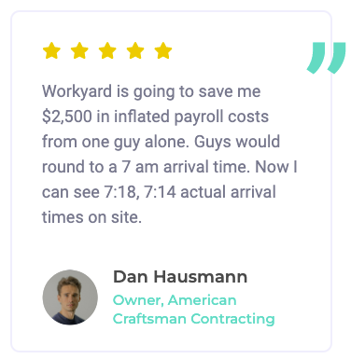
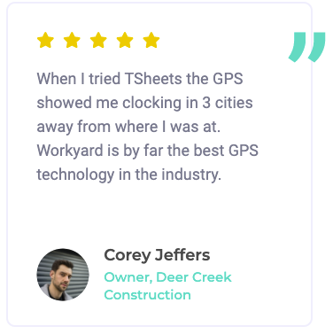
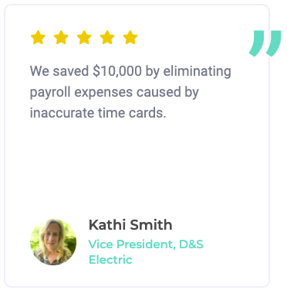
Customer Testimonials
Read more reviews on our website

Slide 7
Easy Rollout Combined With Concierge Level Service
Easy Rollout
Concierge Level Service
1
Invite team members with minimal data input (name + phone number or email)
You’ll have a dedicated account manager to help you along the way.
Your account manager:
Is based in the United States and is always a direct phone call away. No waiting for an offshore call center to respond.
Has deep product expertise and can help fine tune your setup to work for your business.
2
A couple taps for your workers to start clocking in and out every day.
Connect your payroll / accounting system. Automatically import projects, cost codes and team member details.
3
4
Start realizing the benefits in days!

Slide 8
Workyard vs Quickbooks Time: Top 6 Key Differentiators
1️⃣ 100% focused on contractors & field services = A product that fits your business.
2️⃣ IJW - It Just Works! Easy adoption for workers combined with a glitch-free app.
3️⃣ GPS Accuracy.
4️⃣ Better scheduling with checklists and attachments.
5️⃣ Flexibility to integrate with any system.
6️⃣ Concierge level customer service.
Detailed Comparison: https://www.workyard.com/alternatives/quickbooks-time-alternative

Slide 9
Personalized Pricing Proposal Based On Needs
Per User Price (Paid Annually) | $10 user / month
Number of Users Required | 340
Annual Contract Price | $33,240
Projected ROI Timeframe | 30 days
Note: Our plans are flexible so that if you need to temporarily add more users for a period of time, you can without having to add them to your annual plan. They’ll simply be charged at the monthly per user price listed on our website for the days they are active. You can also opt to increase the number of users in your annual plan at a later date if need be.

Slide 10

Want To Talk It Over?
Book a call with Doug
https://calendly.com/douglas-workyard

